Slide 1
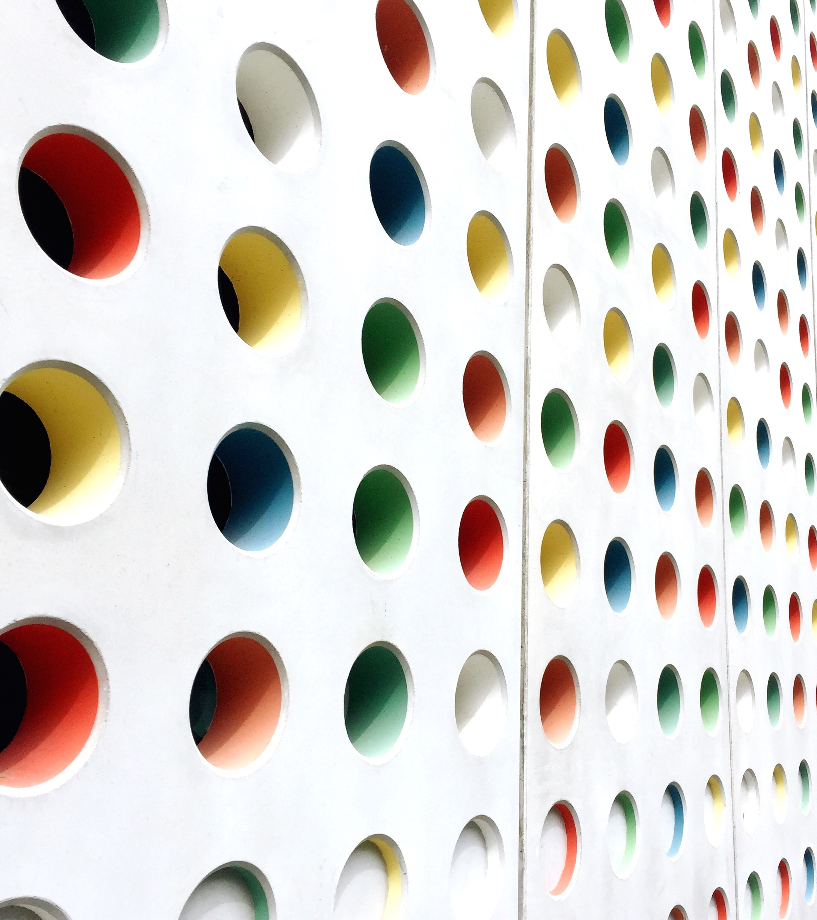
Simple GUI(Graphical User Interface) Calculator
NAME: S. SUJANA KUMARI
AFFILIATION: DIGICROME ACADEMY

Slide 2
PROJECT OVERVIEW
PROJECT GOALS AND OBJECTIVES: The main goal of the project is to create a Simple GUI Calculator using python programming.
The essential features deemed for this application include:
An equation display screen to exhibit the mathematical expressions and their respective results.
Clickable buttons, each representing numerical values or mathematical operations.
Core mathematical operations functionality, encompassing addition, subtraction, multiplication, and division.
Seamless execution of mathematical calculations, yielding results coupled with the ability to clear the equation display.

Slide 3
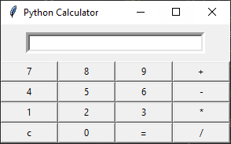
PROJECT OVERVIEW
2. EXPECTED OUTCOME: The expected GUI application should resemble the following features:

Slide 4
METHODOLOGY
GUI calculator using Tkinter Python:
GUI calculator is only a calculator that one can use it by clicking buttons. In the GUI calculator, all its operators and numbers are represented graphically and one can click it and use it.
Tkinter:
Tkinter is the standard GUI library for Python. Python when combined with Tkinter provides a fast and easy way to create GUI applications. Tkinter provides a powerful object-oriented interface to the Tk GUI toolkit.
It is a built in library so no need to install, just need to import.

Slide 5
KEY FEATURES
Creating a GUI root window with a title Simple Calculator with appropriate dimensions.
Including text fields or input fields to enter the numbers.
Including buttons for the following operations: addition, subtraction, multiplication and division.
Including a label or text field to display the result of the operation,
Implement even handlers for each button to perform the corresponding arithmetic operations and display the result in the text field.
Handle any possible error scenarios such as division by zero or invalid inputs.
Include a “clear” button to reset the input field and result field.
Style the GUI elements using appropriate fonts, colors and layout,

Slide 6
CODE EXPLANATION
The code is started by importing the library called the tkinter.
The tkinter library provides all the basic functionality for creating graphical user interfaces.
In order to create a simple calculator, I have defined a calculation variable, this is done by using the global keyword and assigning it an empty string value(“ ”).
Created two functions to update and evaluate the calculation,
The ‘add_to_calcualate’ updates the contents of the text field and ‘evaluate_calculation’ evaluates the final result of the calculation.
Created one more function called ‘clear_field’ to clear the text field when the clear button(‘C’) is clicked.

Slide 7
CODE EXPLANATION
Created a root window and named it as Simple GUI Calculator with appropriate dimensions.
Created two frames in the root window called :
1. display_frame” with appropriate width and height using grid method to insert a text field for displaying all the calculations and expressions.
2. “button_frame” with appropriate width and height using grid method to insert all the buttons in it
Creating series of buttons with the corresponding names like btn1, btn2, btn3 and so on for the numbers to be displayed and btnplus, btnminus, btndivide, btnmultiply etc., for the symbols to be displayed in the text field.
All the buttons are created with specified font, width and height to fit into the button frame, and made attractive by changing foreground and background colors.
Each button is given a command so that when the button is pressed the corresponding command or the function is called and executes.

Slide 8
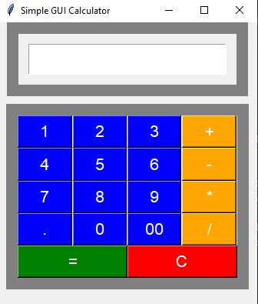
FINAL OUTPUT
The final output of the Simple GUI Calculator is as shown below:

Slide 9


